Slide 1
Data Structures and Algorithms for Nisvartha Foundation Students Session 4 & 5, May 29th 2021 & June 13th 2021 Regular Expressions by example
by
Kumaraguru Muthuraj
Founder Engineer,

Slide 2
What is a Regular Expression?
Regex(p)? for short is a pattern we specify, to search a string, conforming to a well-established standard grammar.
Conceptualized by mathematician Stephen Cole Kleene
https://en.wikipedia.org/wiki/Regular_expression

Slide 3
Simple Patterns
? The question mark indicates zero or one occurrences of the preceding element. For example, colou?r matches both "color" and "colour".
* The asterisk indicates zero or more occurrences of the preceding element. For example, ab*c matches "ac", "abc", "abbc", "abbbc", and so on.
+ The plus sign indicates one or more occurrences of the preceding element. For example, ab+c matches "abc", "abbc", "abbbc", and so on, but not "ac".
{n} The preceding item is matched exactly n times.
{min,} The preceding item is matched min or more times.
{,max} The preceding item is matched up to max times.
{min,max} The preceding item is matched at least min times, but not more than max times.
. Means any character.

Slide 4
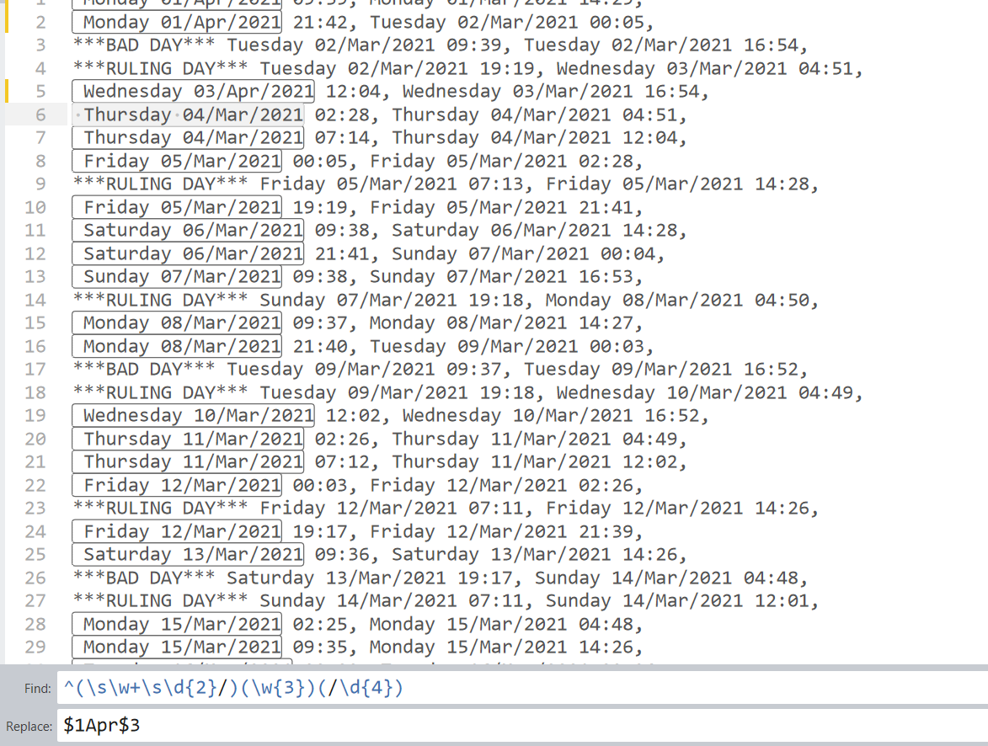
Using groups to replace
Mar with April in the first occurence

Slide 5
Reach Kumaraguru Muthuraj at tradeparallel.tes@gmail.com for any questions related to interview preparation.
Know more at https://www.linkedin.com/in/yogikumar

