Slide 1
Data Structures and Algorithms for Nisvartha Foundation Students Session 3 May 23rd 2021 Time and Space Complexity by example
by
Kumaraguru Muthuraj
Founder Engineer,

Slide 2
Understanding time complexity
Summarize – What is the proportional increase in time taken to complete the algorithm when data size increases?
Space complexity – Similar to time complexity. What is the relative increase in space taken to run the algorithm as data size increases.
Contents – Cracking the Coding Interview by Gayle Laakmann McDowell.

Slide 3
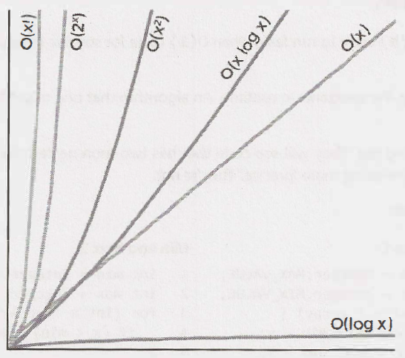
Comparison of time complexity algorithms
Which is faster?

Slide 4
int product (int a, int b) {
int sum = 0;
for (int i = 0; i < b ; i++) {
sum += a;
}
return sum;
}
Time complexity - O(b)
Space complexity - O(1)

Slide 5
int power(int a, int b) {
if (b < 0) {
return 0;
} else if (b == 0) {
return 1;
} else {
return a * power(a, b-1);
}
}
Time complexity - O(b)
Space complexity - O(b)

Slide 6
int mod(int a, int b) {
if (b <= 0) {
return -1;
}
int div = a / b;
return a - div * b;
}
Time complexity - O(1)
Space complexity - O(1)

Slide 7
int div (int a, int b) {
int count = 0;
int sum = b;
while (sum <= a) {
sum += b;
count++;
}
return count;
}
Time complexity - O(a - b)
Space complexity - O(1)

Slide 8
int sqrt(int n) {
return sqrt_helper(n , 1, n);
}
int sqrt_helper(n , 1, n) {
if (max < min) return -1;
int guess = (min + max) / 2;
if (guess * guess == n) {
return guess;
} else if (guess * guess < n) {
return sqrt_helper(n, guess+1, max);
} else {
return sqrt_helper(n, min, guess-1);
}
}
Time complexity - O(log n)
Space complexity - O(log n)

Slide 9
int sqrt(int n) {
for (int guess=1; guess * guess <= n; guess++) {
if (guess * guess == n) {
return guess;
}
}
return -1;
}
Time complexity - O(sqrt(n))
Space complexity - O(1)

Slide 10
If a binary search tree with n nodes, is totally skewed, what is the worst case time taken to find a node?
Time complexity - O(n)
Space complexity - O(1)

Slide 11
int sumDigits(int n) {
int sum = 0;
while (n > 0) {
sum += n % 10;
n /= 10;
}
return sum;
}
Time complexity - O(number of digits) = O(log n)
Space complexity - O(1)

Slide 12
Reach Kumaraguru Muthuraj at tradeparallel.tes@gmail.com for any questions related to interview preparation.
Know more at https://www.linkedin.com/in/yogikumar

