Slide 1
Data Structures and Algorithms for Nisvartha Foundation Students Session 1 May 9th 2021
by
Kumaraguru Muthuraj
Founder Engineer,

Slide 2
Why are we here?
How to get a programmer job in a software company?
Why is Data Structures and Algorithms skills important? What do companies expect from fresh engineers (even with 20 years experience)?
Beginner material relevant to current times.
How to prepare for interviews?
How to be a good problem solver, long term?
How to approach any problem? How to standout from other candidates?

Slide 3
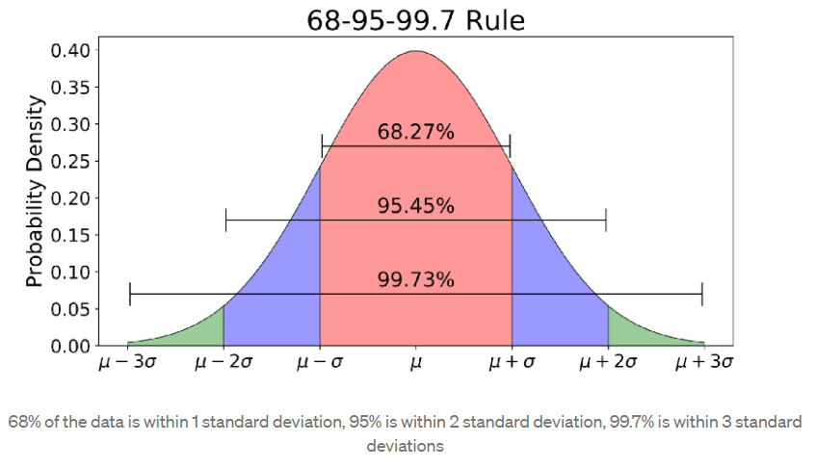
How to get a programmer job in a software company?
Dev or QA or DevOps? Gig Work?
Probability is everywhere!
Let’s understand nature. How do most of the people think? How to increase your success rate?
You have to understand how most people think and behave. This will give you an edge. Think like the crowd and leveraging it.
Machine Learning – Bias and Variance, which one to solve for?
Recommendations for 1st and 2nd year engineering students.
Remember – It’s not enough to have knowledge. You have to learn to apply knowledge.
Create your Github account TODAY! Commit everyday! History is important.

Slide 4
Why is Data Structures and Algorithms Skills important?
If you want to master any programming language, you must do data structures and algorithms in it.
This is an aptitude test.
Most relevant to what you do.
Demonstrates thinking and knowledge. Shows that you have put in effort to read books and practice.
What do companies expect from fresh engineers?
How quickly he codes? What is his speed? Is she coding right? Is she hands-on?
Is she asking the right questions? Is she reading books? Does she have multiple solutions?
What programming language is the best for interviews?
Apply the rule in slide 3. Ask yourself, what programming language the interviewer will be comfortable with? What programming language will most of the interviewers know? Is it C, C++, Java, Python, JavaScript?
You have to practice in a language that is used by 68% people. Your probability of speaking the same language increases the odds of passing the interview.

Slide 5
Beginner material relevant to current times
Programming book – Thinking in Java by Bruce Eckel
Data Structures Beginner book – Data Structures and Algorithms in Java by Robert Lafore.
Text book - Introduction to Algorithms, 3rd Edition (The MIT Press) 3rd Edition by Thomas H. Cormen
Problem solving - Cracking the Coding Interview: 189 Programming Questions and Solutions by Gayle Laakmann McDowell
Probability work book - Permutation, Combination and Probability: Basic to Advanced - Umesh Gupta
Aptitude book – Quantitative Aptitude by R. S. Aggarwal
Avoid Hacker Rank, Leetcode, Educative.io, Algoexpert until Cracking the Coding Interview is finished.
Free e-books

Slide 6
How to prepare for interviews?
Have a GOAL – Finish book X in 90 days. Spend Y hrs a day at time T everyday, including weekends.
Ultradian Rhythm of the Brain – Don’t study for more than 1.5 hrs in a stretch. You must take about 20 mins of rest between 1.5 hrs of study time. In the 1.5 hrs of study time, NO breaks.
Read faster with the index finger of your left hand as a visual guide.
Your brain develops a habit - it’s called Neuroplasticity. Whatever direction you train your brain, it will develop that skill.
Every day spend 15 minutes to do speed reading, take a 10 minute break and start your algorithm practice. In about 30 days, you will see sharp changes in your brain function.
1 Algorithm a day and you can finish problem solving book in 6 months. If you can grasp 2 algorithms you can finish the book in 3 months. Feel free to code one and grasp the concept in the next one. Once you finish the book you will have lot of confidence and you can revisit unsolved problems.
You should be able to code a medium or hard problem in 30 – 45 minutes.
Give time everyday at the SAME time. Things work! Over a period of few years, you will see that you have become an expert problem solver.
Reduce TV, Social Media time to 30 mins and do it during the most non-productive hours of the day.

Slide 7
How to be a good problem solver, long term?
Bias and Variance – If you solve for long term, you are solving for low variance – Pick a good text book and have a deep ground on fundamentals – introspect, ask questions, compare what you studied. If you are on Hacker Rank or Educative.io, you are solving for low bias. A combination of both is required in the long run.
Leaders are Readers - People who read a lot of books are the most successful in the World; they read fast, so fast that their WPM is 600+.
Have a plan. For example, the author of these slides, is building “Probabilistic Algorithms” skill and has bought 2 books. He plans to read 1 book in 2 months, by going deep into each algorithm. By the end of 4 months, he would have known enough about the applications of probabilistic algorithms.
Be Full-Stack – Know all the layers and master 1 or 2. What are the layers? Development, Back-End, UI, Testing, Databases, DevOps with at least 1 Cloud vendor. For this you need a plan and a deadline.

Slide 8
How to approach any problem?
How to standout from other candidates?
Problem: Find a number t in a sorted list A and return its index.
Solution 1: Look up the number from the beginning and go till the point where you find. This is a brute force algorithm. Quick solution. No heuristic applied, no advantage of nature of data taken into consideration.
Solution 2: Don’t jump on to writing the code immediately. Ask follow up questions. These will help decide the datatypes to be used, iterative or recursive approach and other decisions. You don’t have to go to scalability issues, just ask what they are expecting. Is this just an algorithm question or much more. Have time and space complexity in mind when designing the algorithm. Apply the rules from 3. Remember, your code should be like a story, variable names tell a lot about how you think. The smallest things you do will tell others a lot!

Slide 9
Binary Search Algorithm
Problem: Find a number t in a sorted list A and return its index.
int binarySearch (int t, ArrayList<Integer> A) {
int L = 0;
int U = A.size() - 1;
while (L <= U) {
int M = (L + U) / 2;
if (A.get(M) < t) {
L = M + 1;
} else if (A.get(M) == t) {
return M;
} else {
U = M - 1;
}
}
}

Slide 10
Binary Search Algorithm
Problem: Find a number t in a sorted list A and return its index.
int binarySearch (int t, ArrayList<Integer> A) {
int L = 0;
int U = A.size() - 1;
while (L <= U) {
int M = L + (U – L) / 2;
if (A.get(M) < t) {
L = M + 1;
} else if (A.get(M) == t) {
return M;
} else {
U = M - 1;
}
}
}

Slide 11
Binary Search Algorithm
Follow up questions: What if the number repeats? What if the list size is not known? What happens if we want to scale this? Can we use caching? If we want to build a service, how do we do it? Concurrency / Multi-threading?
Approaching a Problem.
Get the code working.
Edge conditions - Unit tests
Time and Space complexity.
Optimize, rewrite the code.

Slide 12
Reach Kumaraguru Muthuraj at tradeparallel.tes@gmail.com for any questions related to interview preparation.
Know more at https://www.linkedin.com/in/yogikumar

